Slide 1
How can the PCWG help with the IEC 61400-15 standard?
 | Normative | Informative
Method
Tool

Slide 2



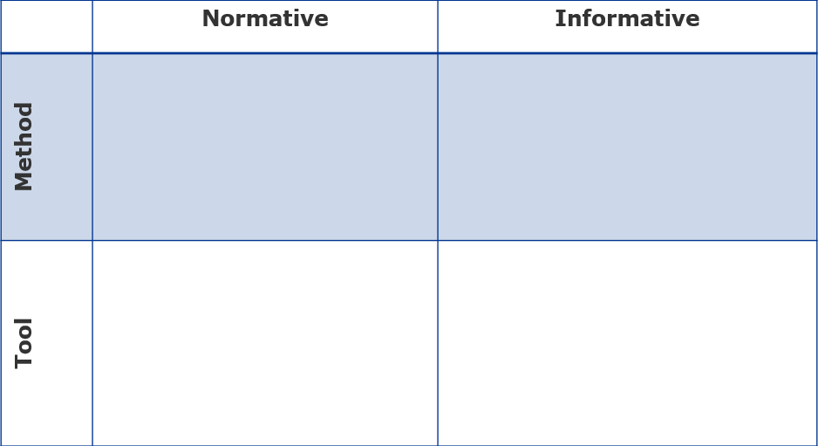
Breakout #1: Support for IEC 61400-15
What actions should the PCWG take to support the IEC61400-15 standard?
Breakout (10 minutes):
Break into 4 groups (mix up)
Identify actions to support to IEC61400-15 standard (record using post-its).
Classify (5 minutes): Classify the possible actions in terms of normative/informative and tool/method.
Regroup Discussion (5 minutes): One person from each group to present key findings.

Slide 3
What one thin﻿g could the PCWG do to add value to you or your organization?

Slide 4
Breakout # 2: The Future of the PCWG
What actions should the PCWG take in 2018-19, to deliver its vision?
Breakout (10 minutes):
Break into 4 groups (mix up)
Identify as many possible PCWG actions as possible (record using post-its) to benefit the wind energy industry (within the scope of the PCWG).
Regroup Discussion (5 minutes): One person from each group to present key findings.
BIG
Prioritisation (5 minutes): Rank the possible actions in terms of ‘effort’ vs ‘benefit/impact’
BENEFIT
Regroup Discussion (5 minutes): One person from each group to present key findings.
SMALL
EASY
EFFORT
HARD

